Slide 1




ReactJS
June 2021
www.hexaware.com | © Hexaware Technologies. All rights reserved.
1

Slide 2
React Introduction
Environment Setup
ES6
React Render Html
JSX
React Components
Props and State
Component API
Component Life cycle
React Forms, Events Refs, Keys
Rest API
React Router
Course Objective
www.hexaware.com | © Hexaware Technologies. All rights reserved. 2

Slide 3


Session Plan
React Introduction
www.hexaware.com | © Hexaware Technologies. All rights reserved.

Slide 4

Web application

Slide 5
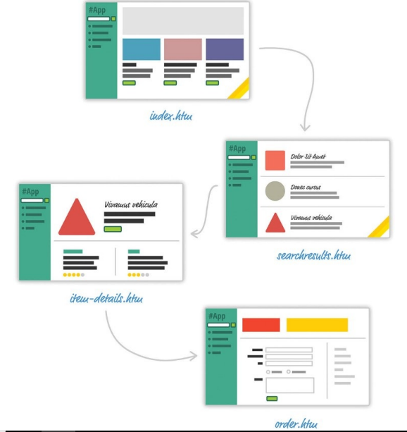
Web application

Slide 6
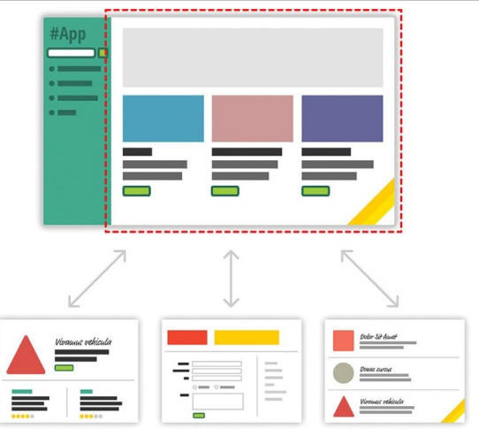
SPA

Slide 7
Challenges in SPA
Manipulating the DOM is really REALLY slow
Working with HTML templates can be a pain
Time will be spent keeping your data in sync with your UI.

Slide 8


Slide 9

Why React
Automatic UI Stage-management
Lightning fast DOM manipulation
APIs for reusable Components

Slide 10

Only the end state matters
Automatic UI Stage-management

Slide 11
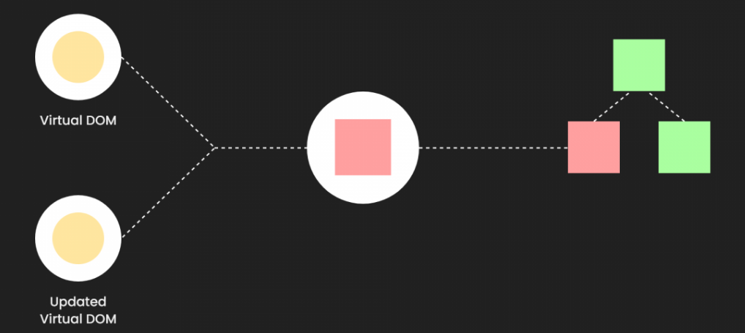
Lightning fast DOM manipulation

Slide 12
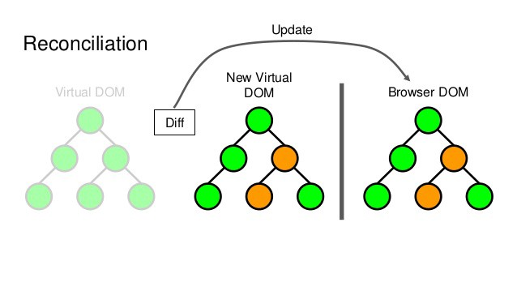
Lightning fast DOM manipulation

Slide 13

Components

Slide 14
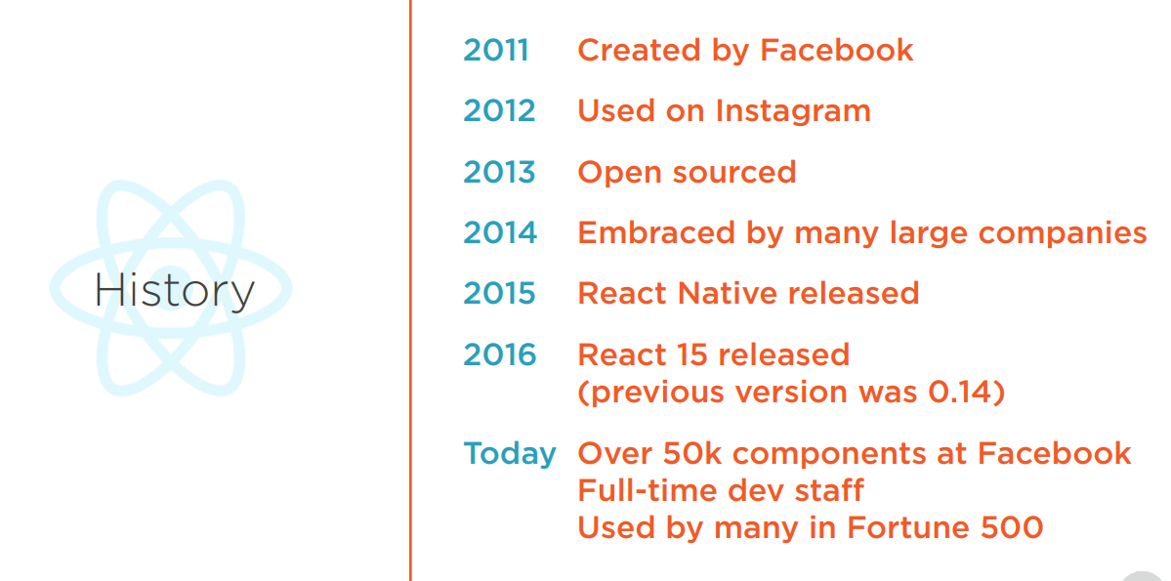
History of React

Slide 15



Thank you
Innovative Services
Passionate Employees
Delighted Customers
www.hexaware.com | © Hexaware Technologies. All rights reserved.

